Slide 1
Supplemental Reading
Institutions

Slide 2
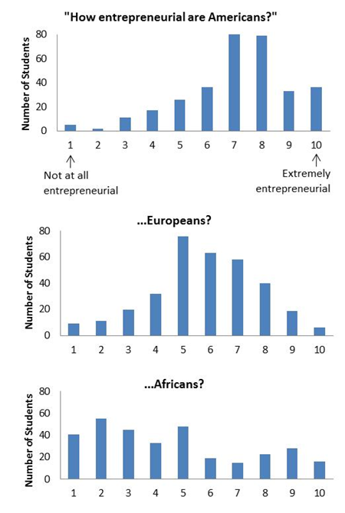
How Entrepreneurial Are We?
Institutions determine “where the money is (Willie Sutton)” in a society and thereby channel the entrepreneurial capacity of a people
Rent seeking vs. productive pursuits?
Responses of undergraduates at UC Davis to the question, “How entrepreneurial are ____?”

Slide 3
What Are Institutions?
Operating systems for societies and economies
  Platform of rules, conventions, norms, and processes
  Affect how we make decisions, how our decisions affect others, and how all these decisions and interactions work together to create markets and the broader society.
  Often function in the background of our lives and go underappreciated—that is, until they get buggy and crash.

Slide 4
Examples of Institutions
Concrete: Banks (financial institutions), institutions of higher learning (UCD), mental institutions, the military
Not-so-concrete: Democratic institutions, codes of dress, modes of greeting people, symbolic communication systems such as spoken language.
  Social conventions and institutions do not specify what “is done”, but rather what “ought to be done.”
  Zoologists: animal institutions in the wild

Slide 5
Corruption Is an Institution
Bends the rules of the game in favor of some people to the detriment of others – and to society as a whole.
Creates serious obstacles to economic development
  Diverts the energy of clever people into corrupt instead of productive pursuits
  Turns laws and law enforcement into opportunities for personal gain instead of broader social benefit.

Slide 6
Point: Institutions Matter Big Time
Inclusive Institutions
  Political systems that are pluralistic, protect individual rights, and create the conditions that reward innovation and entrepreneurship, including secure private property and competitive markets
Extractive Institutions:
  Concentrated political power and economic institutions that reinforce and often enrich the powerful few.
    Like mining: Gold mining extracts but does not create gold
Daron Acemoglu (MIT) and James Robinson (Harvard), Why Nations Fail (2012)

Slide 7
Why Nations Fail
Acemoglu & Robinson (2012)
Differences in economic and political institutions are the dominant explanation for why some countries are rich and others poor
Institutions can be a potent economic force because of the positive or negative dynamics they trigger
Elites may not want things to improve, since genuine improvements may deteriorate their power.

Slide 8
Counterpoint: Institutions Aren’t Everything
(Jeffrey Sachs)
Authoritarian elites aren’t necessarily hostile to economic progress
The diffusion of technology from other countries sometimes matters more than innovation
Even if we could magically transform institutions, unfavorable geography and other factors may continue to constrain growth and development
(If Sachs isn’t right about this, do millennium villages make sense?)

Slide 9

World Bank president calls corruption 'Public Enemy No. 1'
WASHINGTON Thu Dec 19, 2013 1:49pm EST

Slide 10
Institutions Matter, But How Much?
Hard because of the reflection problem (Ch.11 and James Bond)
  Institutions shape economic development
  Economic development enables countries to invest in stronger institutions (like better law enforcement).
  It’s a chicken-and-egg problem.

Slide 11
The Reflection Problem
The treatment (“good” institutions) and the outcome you want to measure (development) move together
  Institutions shape economic development
  Economic development enables countries to invest in stronger institutions (like better law enforcement).
Like a Hall of Mirrors: How can you separate the bad guy (the treatment) from his reflections (the outcome)?
  Some pistachio nuts could help…
  They are an “instrument”

Slide 12
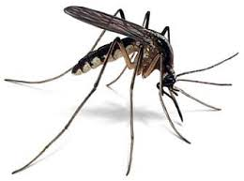
An Instrument for Institutions: Malaria?
If Europeans could live in a place without a constant threat of tropical diseases or other hazards, they tended to import more inclusive institutions
If mortality risks kept Europeans from settling en masse in a location, they opted for more extractive institutions
“Settler mortality risk” as instrument for extractive institutions?
Daron Acemoglu (MIT) and James Robinson (Harvard), Why Nations Fail (2012)

Slide 13
So Where Do Institutions Come From?
William Easterly: Top-down vs. bottom-up
The top down view: institutions are created by leaders and legislators who govern and establish laws.
The bottom up view: institutions emerge and constantly evolve
  …based on the social norms, traditions, values & beliefs of individuals as they interact and exchange with each other in a society
  laws are codified and accepted after (because) they seem reasonable & useful to people

Slide 14
Why Does It Matter?
Top down: Leaders and legislators can determine a society’s institutional path
  Including revolutionary do-overs
  External pressure for change?
Bottom up: Institutions only change gradually, as individuals change their values or beliefs.
  Astute leaders and legislators formalize these institutions into laws and regulations
  Institutions are “evolutionary rather than revolutionary.”

Slide 15
What It Means for Us
Top down view: Experts are needed to help craft and refine institutions
Bottom up view: Little room for experts to engineer institutions to solve social or economic problems
  …and woe to the leader who tries to change institutions, if people aren’t ready to change!

Slide 16
A Middle Road
Institutions govern individual behavior and social interaction in profound ways – and they exist for specific reasons
Still may be room to impose institutions from the top down in the form of laws and regulations
  …but must appreciate the richness & complexity of pre-existing norms, values, beliefs
Societies evolve different institutions even in the long run
  Wit: China’s unique mix of political and economic institutions

Slide 17
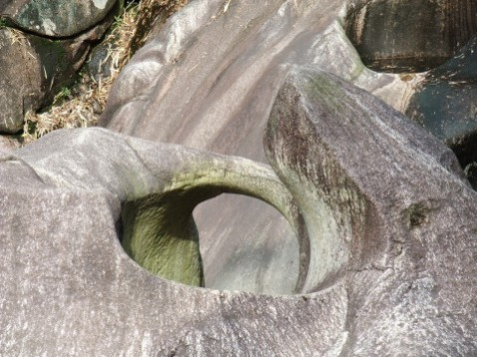
水滴石穿 — Shuĭ Dī Shí Chuān
(Water Drops Pierce Stone)
But development cannot wait!

Slide 18
"Without effective institutions, poor people and poor countries are excluded from the benefits of markets."
World Bank Chief Economist and Senior Vice President Nicholas Stern

Slide 19
Boxes
How Market Institutions Make It Tough to Do Business in Sub-Saharan Africa
Do Land Rights Make People More Productive?

